Slide 1
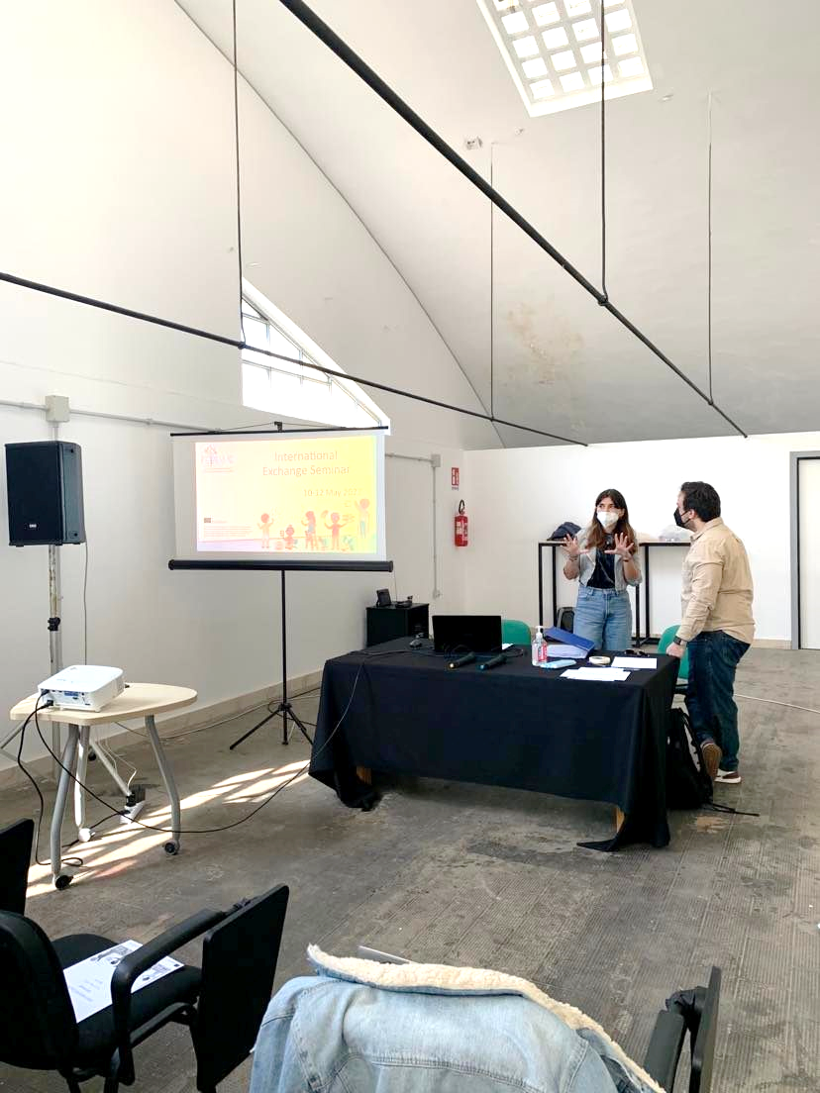
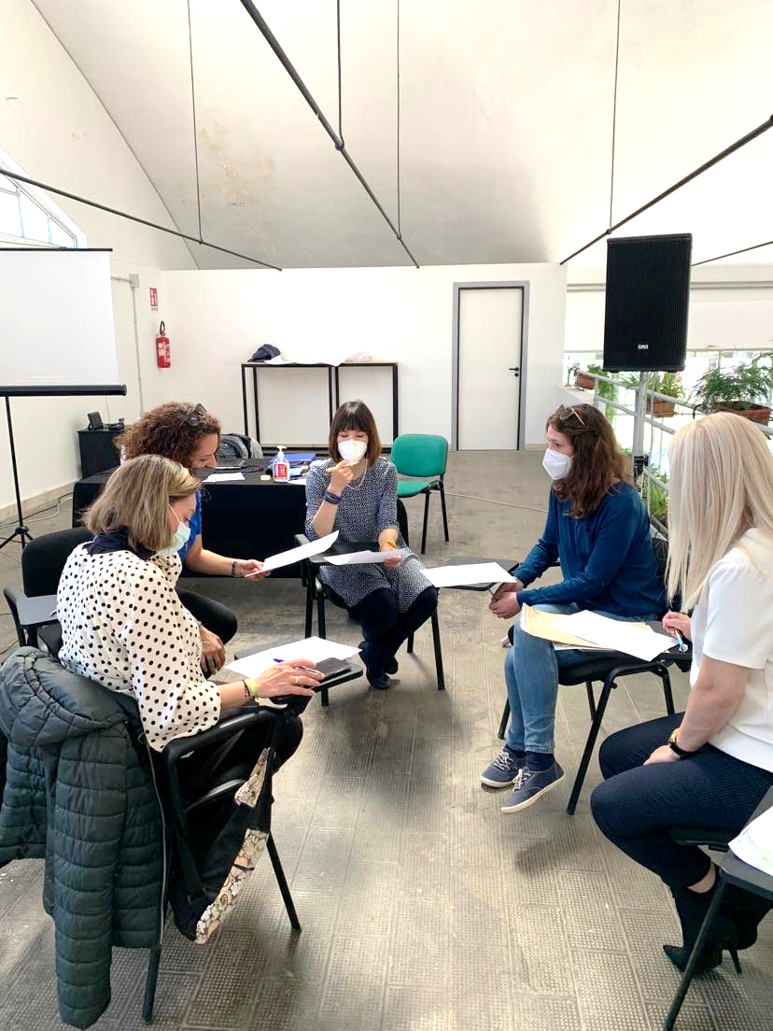
Newsletter issue 2
Μαυ 2022
Mentoring Programme
Since the beginning of the year, all partner countries (i.e., Greece, Cyprus, Austria, Spain, and Italy) selected four secondary education schools to collaborate for the mentoring programme.
Considering the dynamic relationship of the mentorship, a mentor, who is well integrated into the educational system of the country, is paired with a mentee. The aim is to help the newly arrived migrants on educational and cultural level to feel included.
International Exchange Seminar
Teachers and students (mentors and mentees) enrolled in the project, participated on the International Exchange Seminar in Palermo, which lasted 3 days (10-13 of May 2022). Everyone had the opportunity to meet each other face to face.
Students learned more about their role as mentors and mentees, talked about their feelings and thoughts about mentoring. Teachers challenged their biases on mentoring and discuss the different educational systems in Italy, Austria, Cyprus, Greece, and Spain. What is more, everyone learned and challenge their thoughts about diversity and inclusion through playing different activities organized by CESIE.

Slide 2
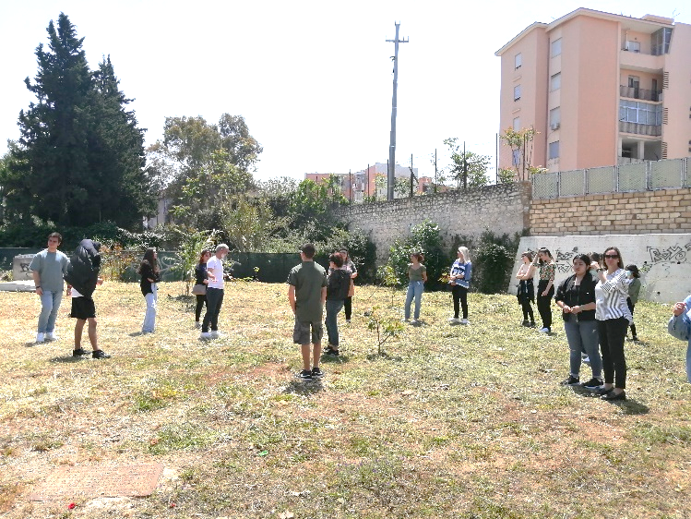
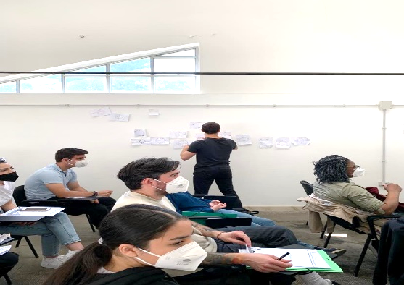
What is Next: Prior
Assessment Tool
After the International Exchange Seminar in Palermo, partners had the opportunity to meet for the first time face to face. More specifically, they discuss about the situation in Ukraine and emphasized the need to help newly arrived migrants to feel included in the host country.
Furthermore, one of the following steps of the project is to launch its prior assessment tool. The prior assessment tool evaluates the prior knowledge and skills of the newly arrived migrants in order for the teachers to be aware of the knowledge level of the students. This will be helpful, mainly to the teachers, so that to tailor their subject to the needs and gaps of the students.
Consortium
.
FEINAMC
Follow us on
FACEBOOK
Follow us !
Project No. 621545-EPP-1-2020-1-ES-EPPKA3-IPI-SOC-IN
The European Commission support for the production of this publication does not constitute an endorsement of the contents, which reflects the views only of the authors, and the Commission cannot be held responsible for any use which may be made of the information contained therein.
https://feinamc.eu/

