Slide 1
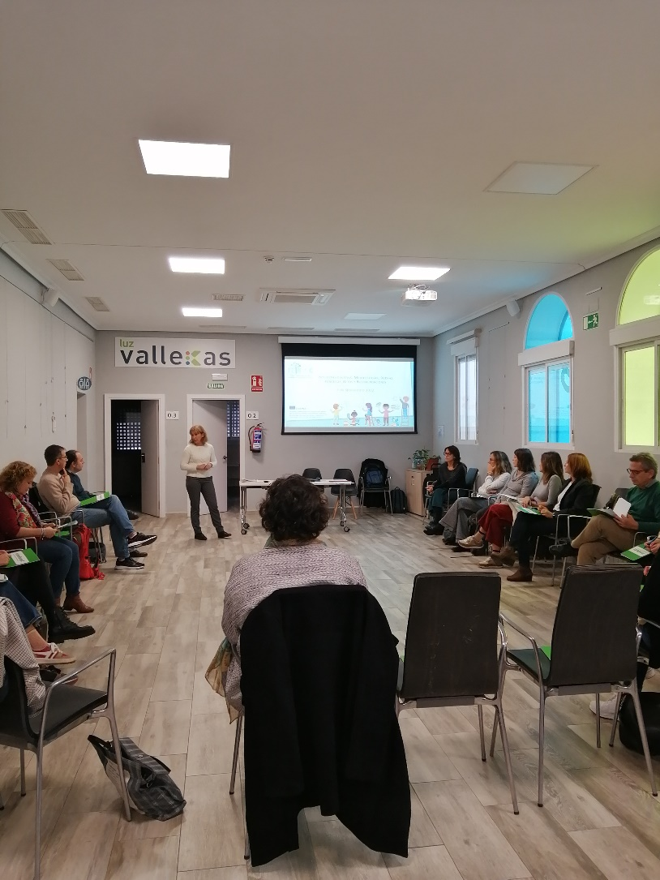
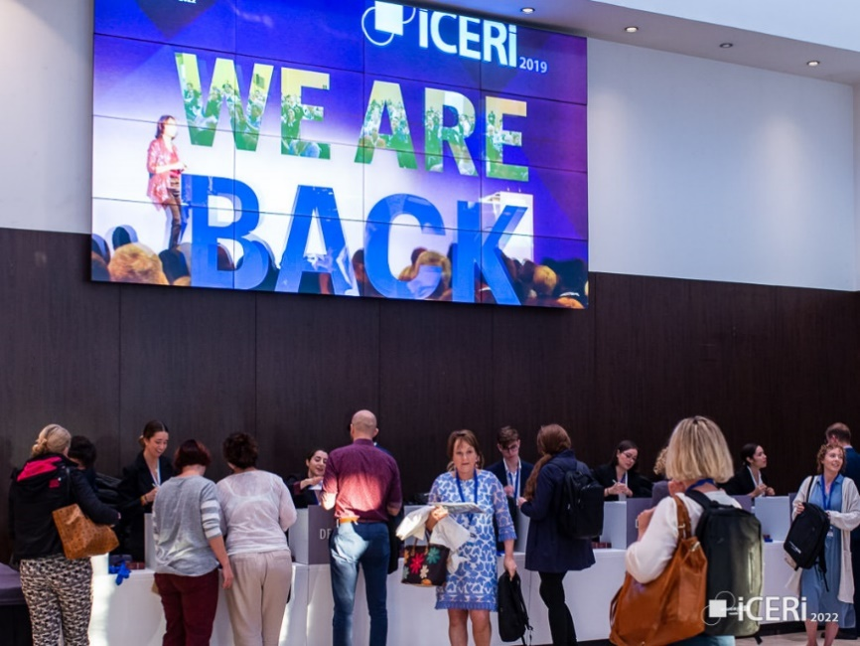
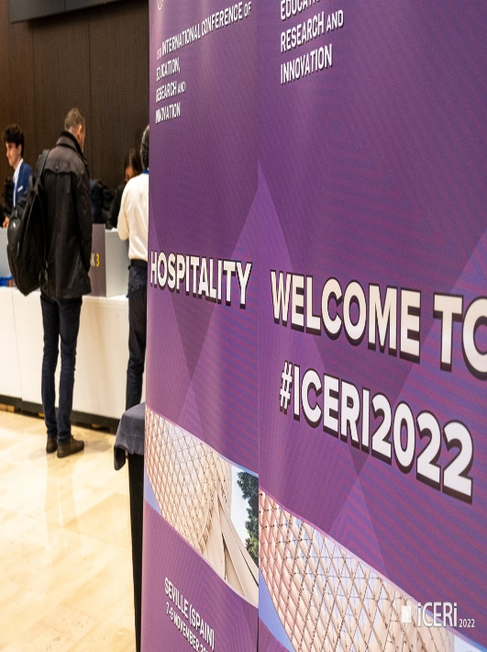
Newsletter issue 4
December 2022
Second Info Day
These last months, Spain and Austria had the opportunity to present the project’s results to different educational authorities from local and regional educational institutions who work with the migrant population.
What is more, participants had the opportunity to discuss and give recommendations. Through the discussion it was highlighted that educational inclusion depends on other socioeconomic elements and factors and therefore a global analysis is needed when addressing this reality.
International And Local Conferences
We are happy to announce that in September and October 2022, we attended different Local and International Conferences.
Specifically, CARDET virtually presented the results of the FEINAMC application at the ICERI Conference which was held in Seville Spain, in EOK in Cyprus and InteRed had the opportunity to present the application of the project in the different cities in Spain at the X Migration Congress, in Madrid.

Slide 2
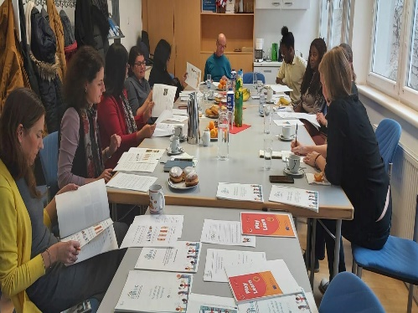
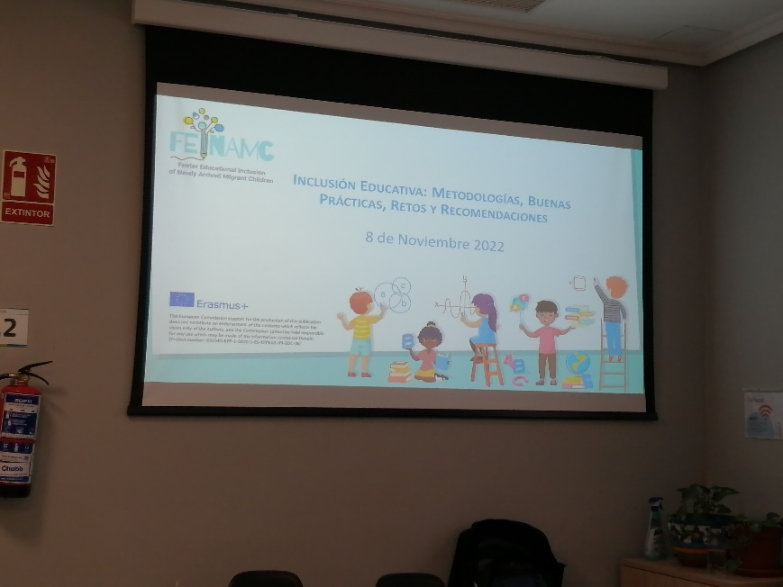
What is Next: International Conference in Spain
We have completed one academic year, collected the results of the project so that to create accessible material to be used in the future by other schools and teachers.
More specifically, we are in the process of creating policy recommendations, guidelines for teachers, and the prior assessment tool culturally tailored to the Italian, Spanish, Austrian, Greek, and Cypriot educational system.
Nonetheless, one of our last actions is the International Conference in Spain, which will be held in February 2023. In the conference, different stakeholders will participate and be provided with all the outputs of the project.
Consortium
.
FEINAMC
Follow us on
FACEBOOK
Follow us !
Project No. 621545-EPP-1-2020-1-ES-EPPKA3-IPI-SOC-IN
The European Commission support for the production of this publication does not constitute an endorsement of the contents, which reflects the views only of the authors, and the Commission cannot be held responsible for any use which may be made of the information contained therein.
https://feinamc.eu/

